Slide 1

Geometry
Unit 11, Lesson 7 Centroid of a Triangle Volume 2, pg. 213

Slide 2


Benchmarks
MA.912.GR.1.3
Prove relationships and theorems about triangles. Solve mathematical and real-world problems involving postulates, relationships, and theorems of triangles.
MA.912.GR.5.2
Construct the bisector of a segment or an angle, including the perpendicular bisector of a line segment.
volume 2, pg. 213

Slide 3
Integrated Mathematical Thinking and Reasoning Standards
MA.K12.MTR.1.1 Actively participate in effortful learning both individually and collectively.
MA.K12.MTR.2.1 Demonstrate understanding by representing problems in multiple ways.
MA.K12.MTR.4.1 Engage in discussions that reflect on the mathematical thinking of self and others.
MA.K12.MTR.5.1 Use patterns and structure to help understand and connect mathematical concepts.
MA.K12.MTR.6.1 Assess the reasonableness of solutions.
volume 2, pg. 213

Slide 4

Learning Targets
I can find the centroid of a triangle.
I can use the relationship of the distance a centroid is from a vertex to the midpoint of the opposite side to solve problems.
volume 2, pg. 213

Slide 5

Warm-Up
volume 2, pg. 214

Slide 6
11.7.1 Warm-Up: Bell Work
Given $∆BMT$, where $MB=7$, $MT=12$, and $BT=9$, list the angles in order from least to greatest.
volume 2, pg. 214

Slide 7

Exploration
volume 2, pg. 214

Slide 8

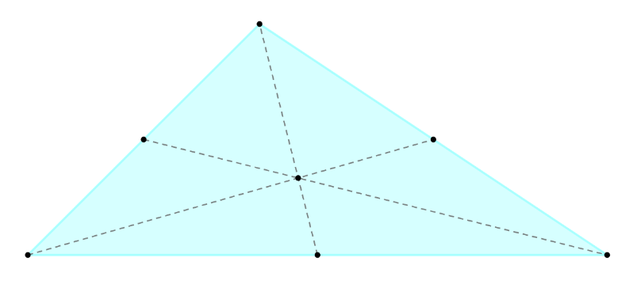
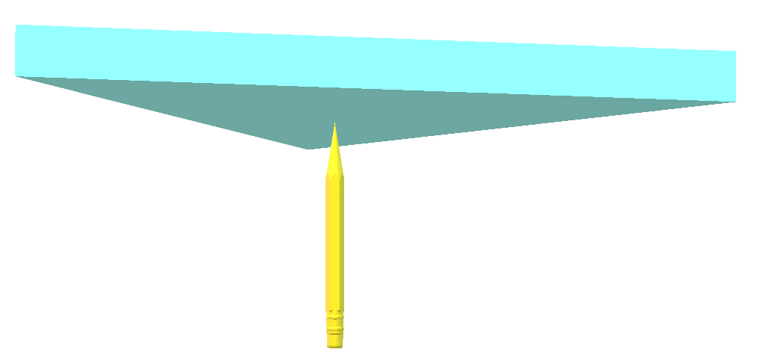
11.7.2 Exploration: Centroid of a Triangle
All polygons have a balancing point. The diagrams show the balancing point of a triangle.
What do you notice?
Discuss with your partner how you think the balance point was found. Summarize your discussion.
volume 2, pg. 214

Slide 9
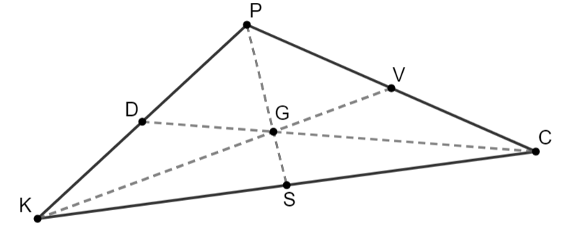
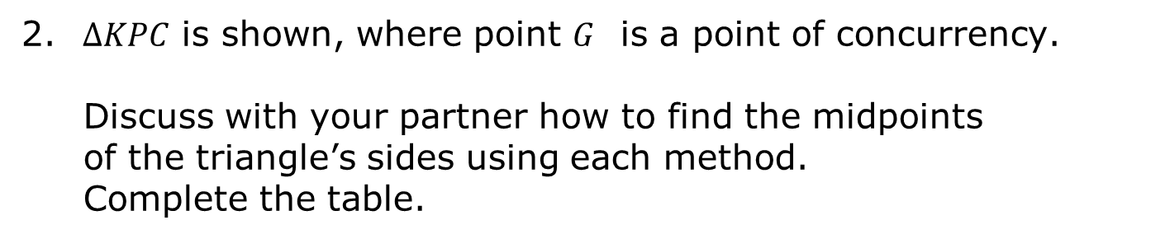
A median of a triangle is a segment that joins any vertex of the triangle to the midpoint of the opposite side.
$∆KPC$ is shown, where point $G$ is a point of concurrency.
Discuss with your partner how to find the midpoints of the triangle’s sides using each method. Complete the table.
Patty Paper | Compass
volume 2, pg. 215

Slide 10
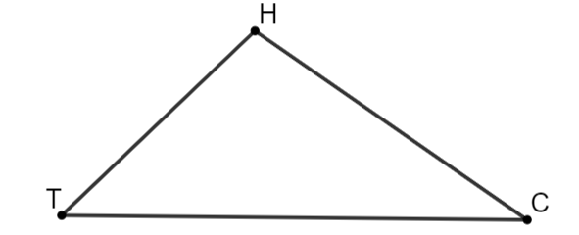
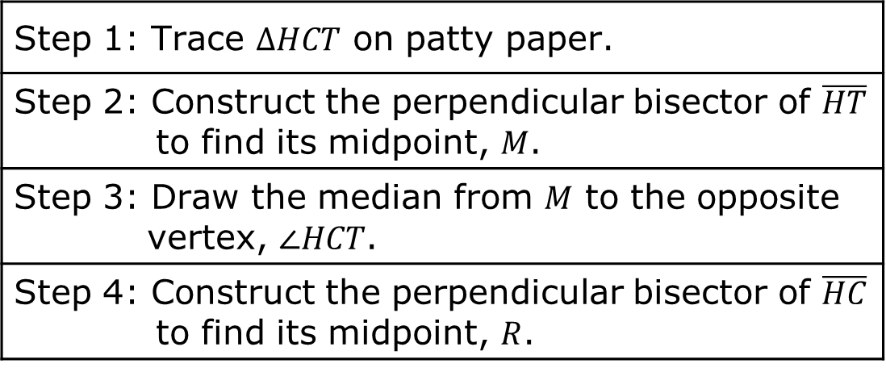
$HCT$ is shown.
Use the steps to construct the centroid of $∆HCT$.
Step 1: Trace $∆HCT$ on patty paper.
Step 2: Construct the perpendicular bisector of $\overline{HT}$ to find its midpoint, $M$.
Step 3: Draw the median from $M$ to the opposite vertex, $∠HCT$.
Step 4: Construct the perpendicular bisector of $\overline{HC}$ to find its midpoint, $R$.
volume 2, pg. 215

Slide 11
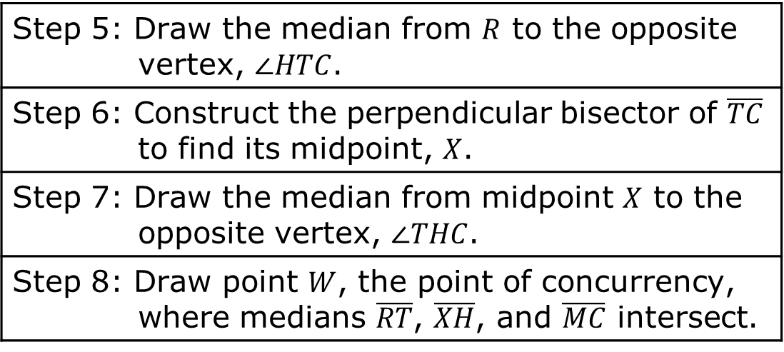
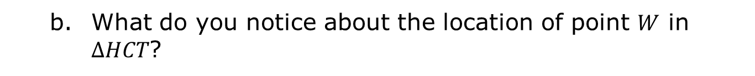
Step 5: Draw the median from $R$ to the opposite vertex, $∠HTC$.
Step 6: Construct the perpendicular bisector of $\overline{TC}$ to find its midpoint, $X$.
Step 7: Draw the median from midpoint $X$ to the opposite vertex, $∠THC$.
Step 8: Draw point $W$, the point of concurrency, where medians $\overline{RT}$, $\overline{XH}$, and $\overline{MC}$ intersect.
What do you notice about the location of point $W$ in $∆HCT$?
volume 2, pg. 215

Slide 12
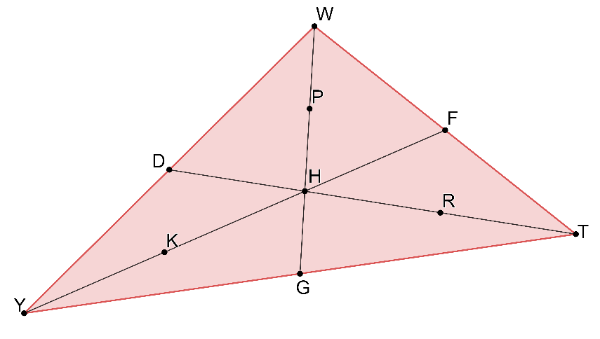
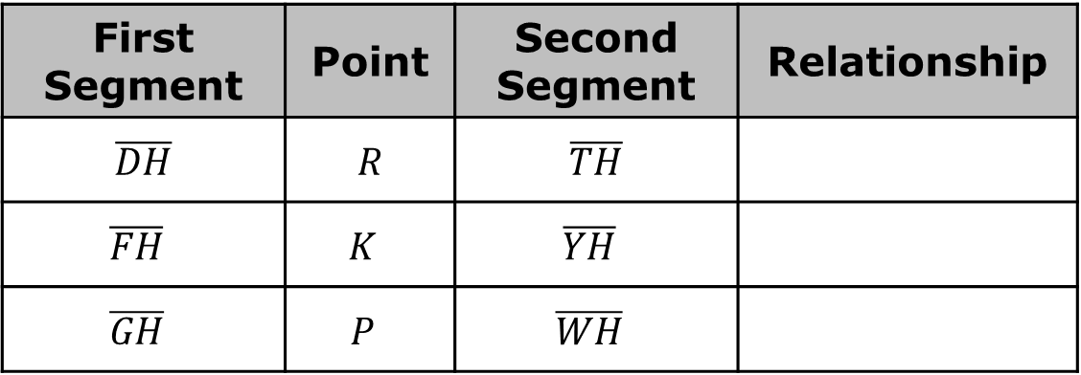
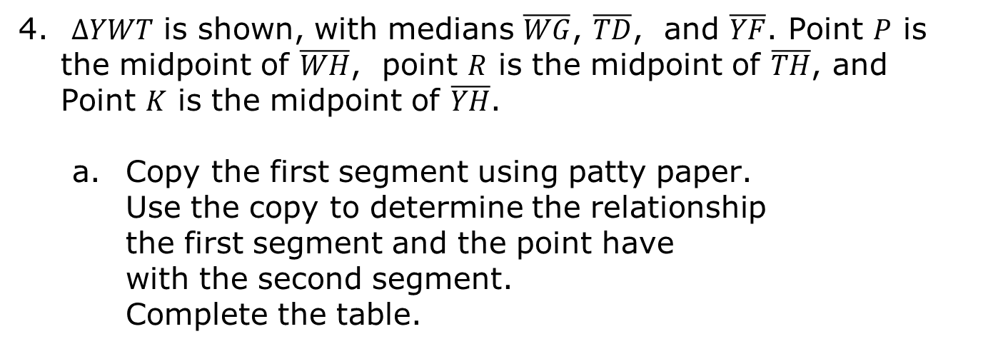
$∆YWT$ is shown, with medians $\overline{WG}$, $\overline{TD}$, and $\overline{YF}$. Point $P$ is the midpoint of $\overline{WH}$, point $R$ is the midpoint of $\overline{TH}$, and Point $K$ is the midpoint of $\overline{YH}$.
Copy the first segment using patty paper. Use the copy to determine the relationship the first segment and the point have with the second segment. Complete the table.
First Segment | Point | Second Segment | Relationship
$$\overline{DH}$$ | $$R$$ | $$\overline{TH}$$
$$\overline{FH}$$ | $$K$$ | $$\overline{YH}$$
$$\overline{GH}$$ | $$P$$ | $$\overline{WH}$$
volume 2, pg. 216

Slide 13
The centroid of a triangle is the intersection of the three medians of the triangle (each median connecting a vertex with the midpoint of the opposite side).
Write a conjecture about the distance a centroid is from the vertex and the distance a centroid is from the midpoint of the opposite side.
volume 2, pg. 216

Slide 14

Guided Instruction
volume 2, pg. 217

Slide 15

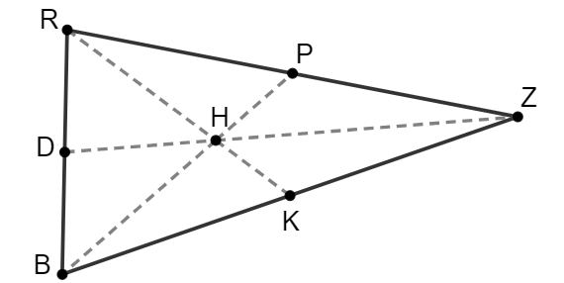
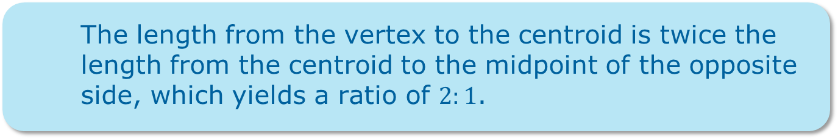
11.7.3 Guided Instruction: Centroid of a Triangle
The length from the vertex to the centroid is twice the length from the centroid to the midpoint of the opposite side, which yields a ratio of $2:1$.
$∆RZB$ is shown, where point $H$ is the centroid of the triangle.
$DH=11.3$, $RK=20.55$, and $BH=15.2$.
volume 2, pg. 217

Slide 16
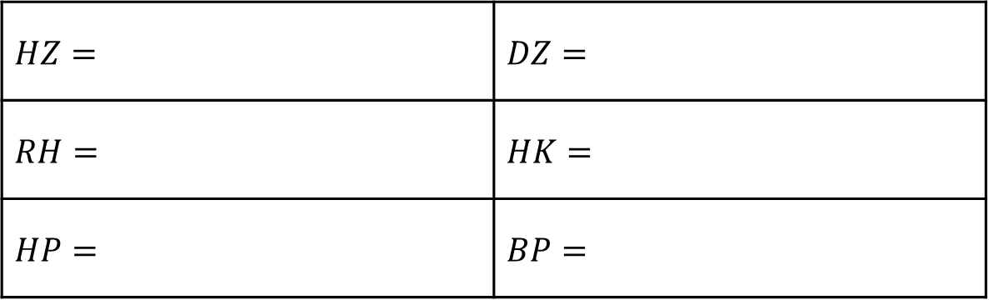

Complete the table.
If $BK=6x+3$ and $KZ=10x−7$, what is the length of $\overline{BZ}$?
$$HZ=$$ | $$DZ=$$
$$RH=$$ | $$HK=$$
$$HP=$$ | $$BP=$$
volume 2, pg. 217

Slide 17
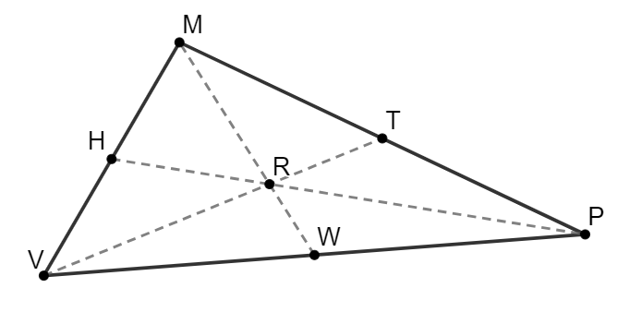
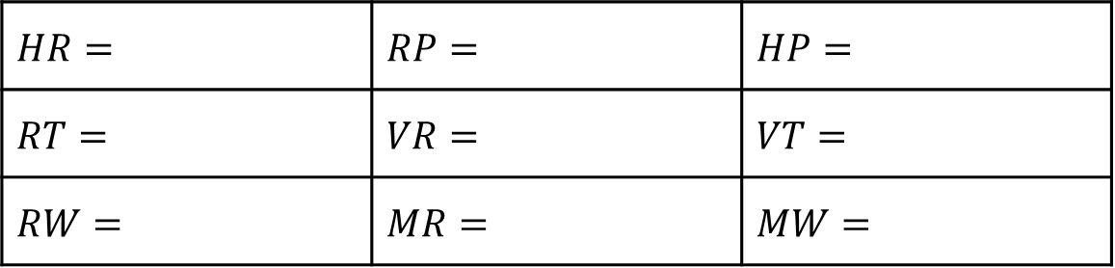
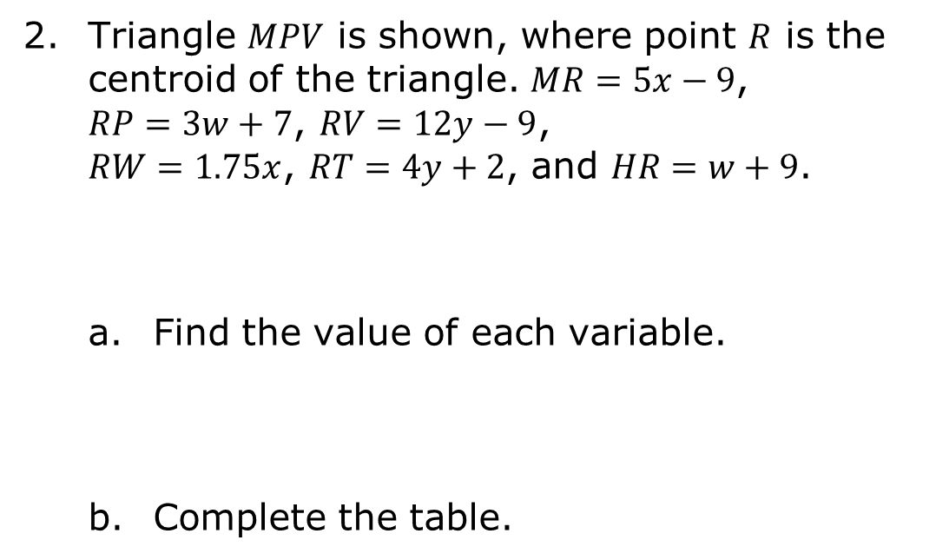
Triangle $MPV$ is shown, where point $R$ is the centroid of the triangle. $MR=5x−9$, $RP=3w+7$, $RV=12y−9$, $RW=1.75x$, $RT=4y+2$, and $HR=w+9$.
Find the value of each variable.
Complete the table.
$$x=$$ | $$y=$$ | $$w=$$
$$HR=$$ | $$RP=$$ | $$HP=$$
$$RT=$$ | $$VR=$$ | $$VT=$$
$$RW=$$ | $$MR=$$ | $$MW=$$
volume 2, pg. 217

Slide 18

Your Turn
volume 2, pg. 218

Slide 19
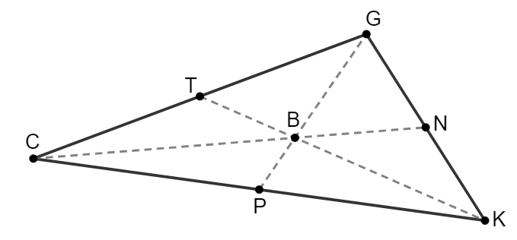
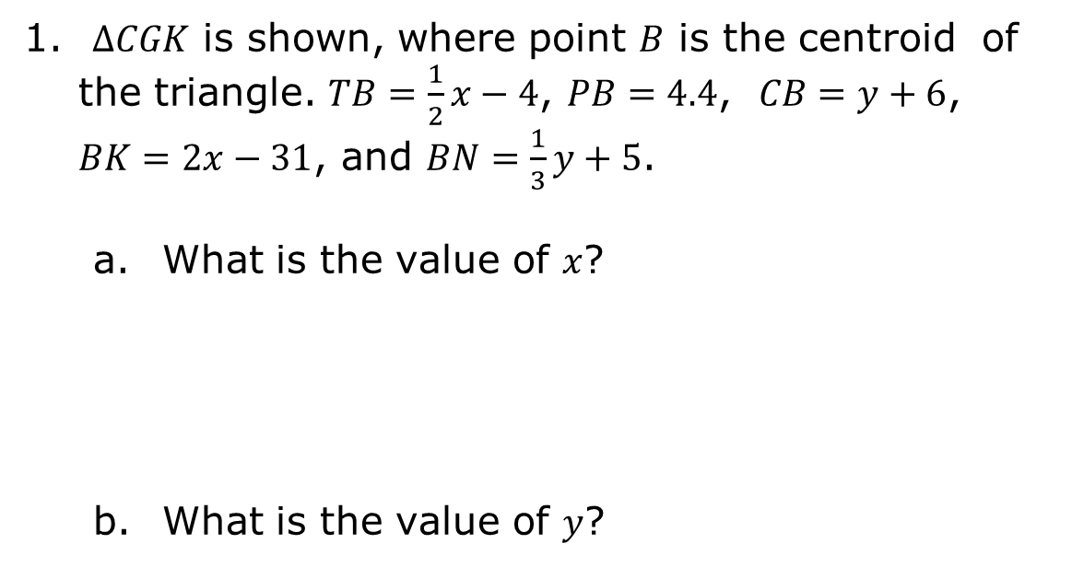
11.7.4 Your Turn!
$∆CGK$ is shown, where point $B$ is the centroid of the triangle. $TB=\frac{1}{2}x−4$, $PB=4.4$, $CB=y+6$, $BK=2x−31$, and $BN=\frac{1}{3}y+5$.
What is the value of $x$?
What is the value of $y$?
volume 2, pg. 218

Slide 20
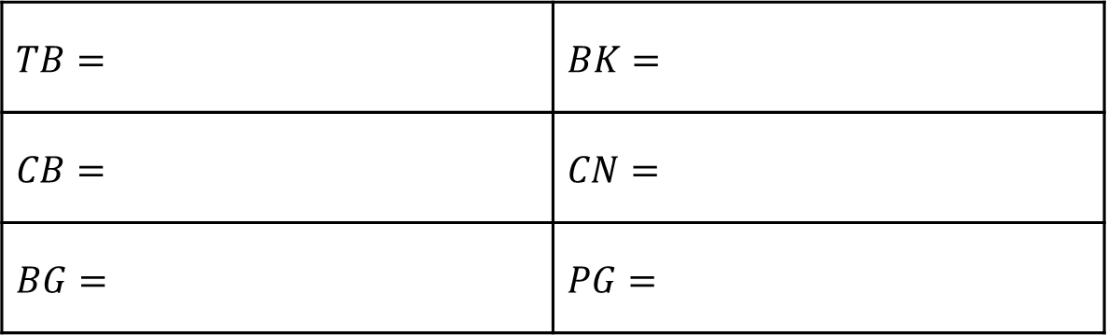
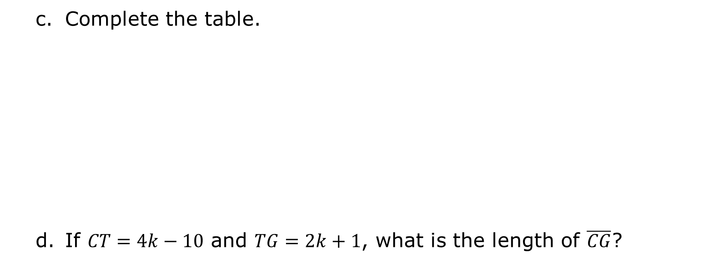
Complete the table.
If $CT=4k−10$ and $TG=2k+1$, what is the length of $\overline{CG}$?
$$TB=$$ | $$BK=$$
$$CB=$$ | $$CN=$$
$$BG=$$ | $$PG=$$
volume 2, pg. 218

Slide 21
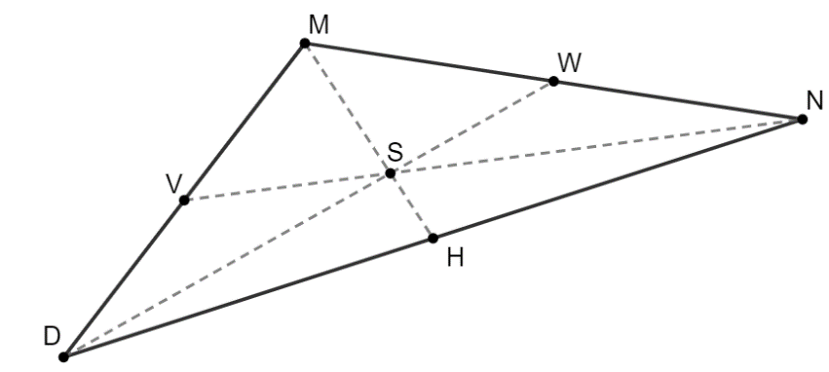
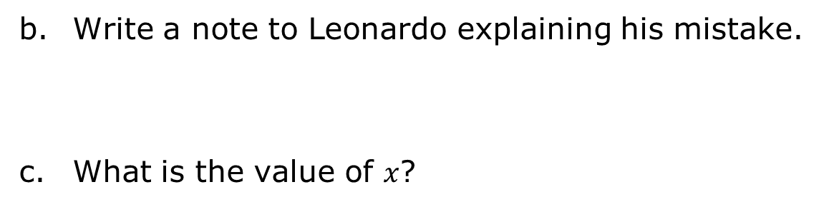
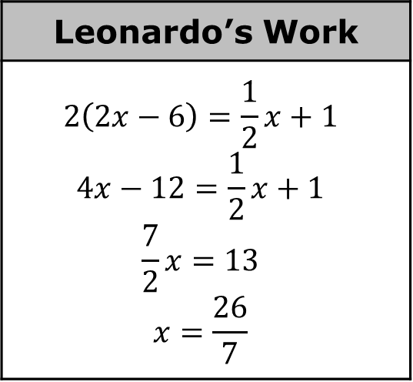
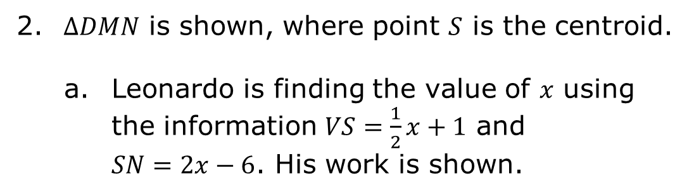
$∆DMN$ is shown, where point $S$ is the centroid.
Leonardo is finding the value of $x$ using the information $VS=\frac{1}{2}x+1$ and $SN=2x−6$. His work is shown.
Leonardo’s Work
$$2\left(2x−6\right)=\frac{1}{2}x+1$$ $$4x−12=\frac{1}{2}x+1$$ $$\frac{7}{2}x=13$$ $$x=\frac{26}{7}$$
Write a note to Leonardo explaining his mistake.
What is the value of $x$?
volume 2, pg. 219

Slide 22

Wrap-Up
volume 2, pg. 219

Slide 23
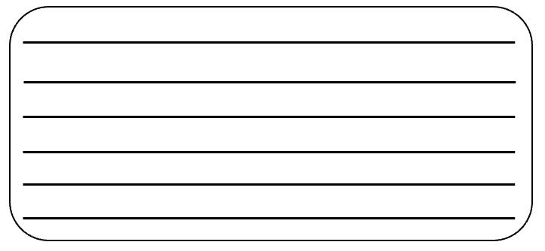
11.7.5 Wrap-Up: Cool Down
Write a short note summarizing today’s lesson to a friend who missed class.
volume 2, pg. 219

